Slide 1
Hypothesis Testing On Bank Marketing Campaign
D19018
Manish Kumar

Slide 2
Bank Marketing Campaign
bank
Client
Other Attribute
Current Attribute

Slide 3
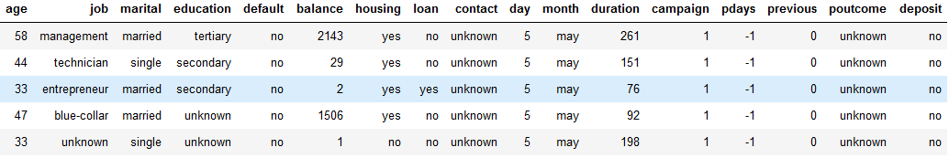
Dataset heading

Slide 4
Variable
Numerical
Categorical
Two Sample t-test
Chi-square test

Slide 5
Client Data
Current Attribute
Other Attribute
Age
Job
Marital
Education
default
hosing
loan
balance
Contact
Month
Day
Duration
Campaign
Pdays
Previous
Poutcome
Deposit

Slide 6
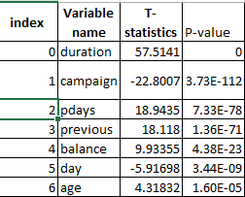
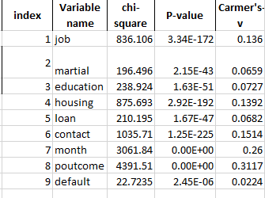
Results of hypothesis testing

Slide 7
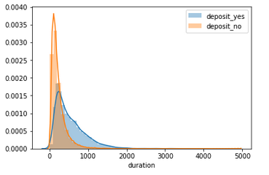
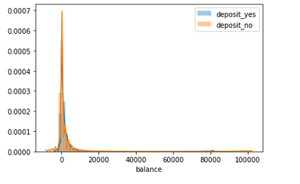
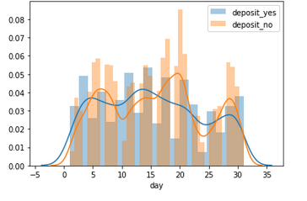
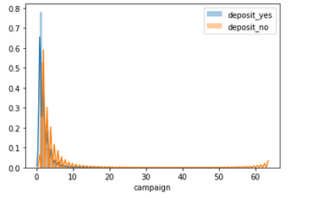
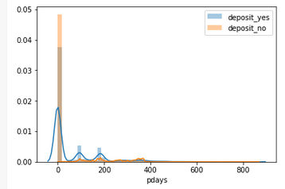
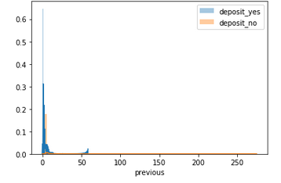
Distribution of numerical variable with Two sample T-test

